Slide 1
The Google File System (Ghemawat et.al., SOSP ‘03)
CS 5540
(Rao)

Slide 2
Introduction (1/2)
GFS was designed to meet Google’s large-scale data processing needs
Goals
Performance, scalability, reliability, availability AND
Based on application workloads and technology – current and future
Failures are a norm rather than an exception
Commodity components
Large scale – 1000’s of machines, and large number of users

Slide 3
Introduction (2/2)
Huge files – multi gigabyte files are common
Revisit design policies such as I/O operations and block sizes
Workload
Appending new data to a file rather than overwriting existing data – almost no random writes (producer/consumer model)
Common case to optimize: Append (should be atomic in nature)
Sequential reads
Caching is not helpful

Slide 4
Design Overview
Assumptions
Inexpensive commodity components, failure is common; monitoring, tolerance, recovery is needed
Large number of large files
Large streaming reads and small random reads
Large sequential writes (small random writes are uncommon)
Well-defined semantics for multiple clients for concurrent appends (minimal synchronization)
High sustained bandwidth than low latency

Slide 5
GFS Interface
Familiar interface like other file systems
Hierarchical organization, directories, path names
Create, delete, open, close, read, and write
Snapshot and record append operations
Snapshot creates a copy of a file or directory tree at a low cost
Record append allows multiple clients to append to a file concurrently with atomicity

Slide 6
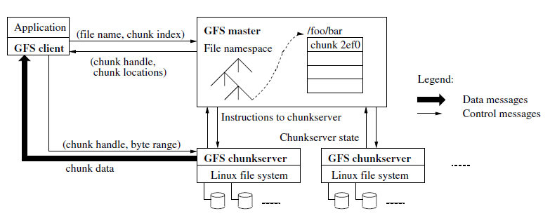
Architecture
Files are divided into fixed-sized chunks, each chunk has a 64 bit handle (globally unique)
Master stores metadata, periodically communicates with chunkservers – instructions to chunkservers, and receives state information from them

Slide 7
Client/Chunkserver/Master
No file data caching on a client or chunkservers
Workload is dominated by sequential reads
Simpler design
A client does cache metadata (filename, chunk handle and locations)
Single Master
Has global knowledge – useful for chunk placement/replication decisions
Not directly involved for client’s data transfer
Provides a client the handle and locations of chunk replicas
Client caches this information to avoid frequent interactions with Master
Otherwise Master can become a bottleneck

Slide 8
Chunk Size
64 MB chunks, stored as Linux files
Advantages
Reduces interaction of clients with Master
Persistent TCP connection to a chunkserver
Client performs many operations on a chunk
Reduces size of metadata stored on the Master
Master can store metadata in memory
Disadvantages
Small files, may be one chunk, hotspot (not a big problem)
Can fix it by having higher replication factor
E.g., executable became a hotspot

Slide 9
Metadata
Master stores metadata, stored in memory – so fast
Small amount of information per file and chunk
The file and chunk namespaces
Logged – for recovery from master crashes
The mapping from files to chunks
Logged – for recovery from master crashes
The locations of each chunk’s replicas
Not logged, master requests chunkservers for information on chunks
Background cleaning/scanning is possible
Chunk garbage collection, re-replication, migration
Notes:
In HDFS, secondary name node does the job of frequently updating the metadata using the log information of the changes, while the name node is servicing clients. Also during the failure of the name node (SPOF), the secondary takes charge. Availalability is not provided by secondary. Poor naming. High availability is not provided by secondary. More recent versions of Hadoop have active and standby namenodes.

Slide 10
Chunk Locations/Operation Log
Master does not store chunk locations persistently, rather polls chunkservers at startup or when a new chunkserver joins
Master can be up-to-date hereinafter; periodic heart-beat messages
Simple design
No need to keep the Master and chunkservers in sync
Can cope with hundreds of chunkservers that fail often
Operation log: Logs critical metadata information
Provides a global time line of changes (concurrent operations)
Recover from master crashes, checkpointing is done periodically
Log is replicated on remote machines
Notes:
Called Editlog in HDFS

Slide 11
Consistency Model
Relaxed consistency model – simple and efficient to implement
A mutation is an operation that changes file data or meta data
Operations/mutations on the metadata – handled by Master
Provides atomicity and correctness
Operations/mutations on file data – a bit tricky
Notes:
Strong consistency is needed in transactional databases. Phil Bernstein’s slides
A – all or none
C – preserves database integrity – consistent state – slightly different than consistency in distributed systems
I – as if transactions execute alone
D – don’t lose data if there are failures

Slide 12
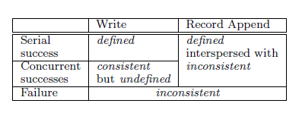
Guarantees by GFS
A file region is consistent if all clients will always see the same data by reading any replica
A region is defined
Consistent + clients see the entire write of a mutation
Notes:
From the point of a reader/client that is reading the changes being made
Two clients trying to write to the end of a file – undefined but consistent – concurrent writes

Slide 13
System Interactions
Minimize Master’s interactions
Leases and Mutation order
A chunk lease given by master makes a replica/chunkserver the primary
The primary picks a serial order for all mutations to a chunk
Apply the same order to all replicas

Slide 14
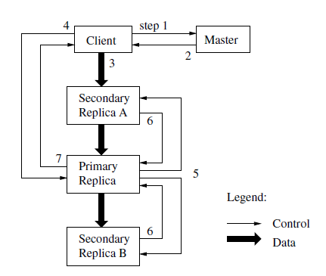
Write Data and Control Flow
See paper for description of each step
Concurrent writes crossing
chunk boundaries or large
writes are broken
into multiple writes by GFS client
Data flow is decoupled from control flow
Pipeline data through chunkservers
in a serial fashion
For append operation, GFS picks an offset
of choice; at-least-once semantics
Notes:
Different serial orders on diff chunks, region becomes undefined but consistent

Slide 15
Questions?
See paper for more details and experiments.

